Slide 1
Machine Learning Lecture - 6
Programming Club, IITK
March 16, 2016

Slide 2
Today’s Lecture
Note:
Unsupervised Learning
Dimensionality Reduction
Knowledge of previous lectures - *not necessary*
Machine Learning is huge - Aimed to get started NOT MASTER
Material in this slide - from various sources (for internal use only)

Slide 3
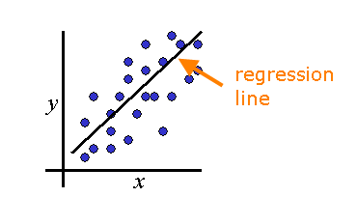


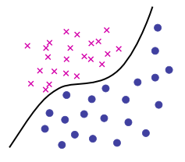


What we have seen so far?
Regression - predicting real-valued output by learning a function using labelled input
Classification - predicting class(out of a set of class) by learning using class labelled input

Slide 4
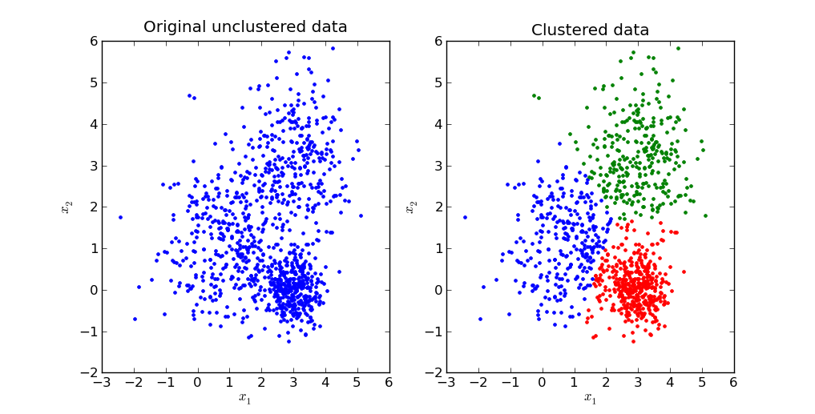
Unsupervised Learning
Learning from dataset without labels
Draw inferences from dataset
Various approaches to Unsupervised Learning Most Common: Clustering

Slide 5
What is Clustering?
Clustering is a technique for finding similarity groups in data, called clusters
Example 1: Group people of similar sizes together to make “small”, “medium” and “large” T-Shirts.
Tailor-made for each person: too expensive
One-size-fits-all: does not fit all.
Example 2: In marketing, segment customers according to their similarities
To do targeted marketing.

Slide 6
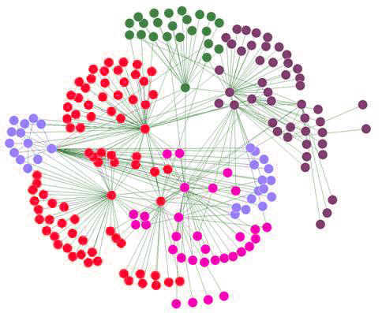
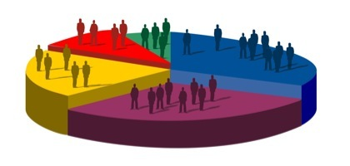
Application of Clustering
Market Segmentation
Social Network Analysis
Computing Clusters Analysis
Many more

Slide 7
K-mean Clustering Algorithm: Overview

Slide 8
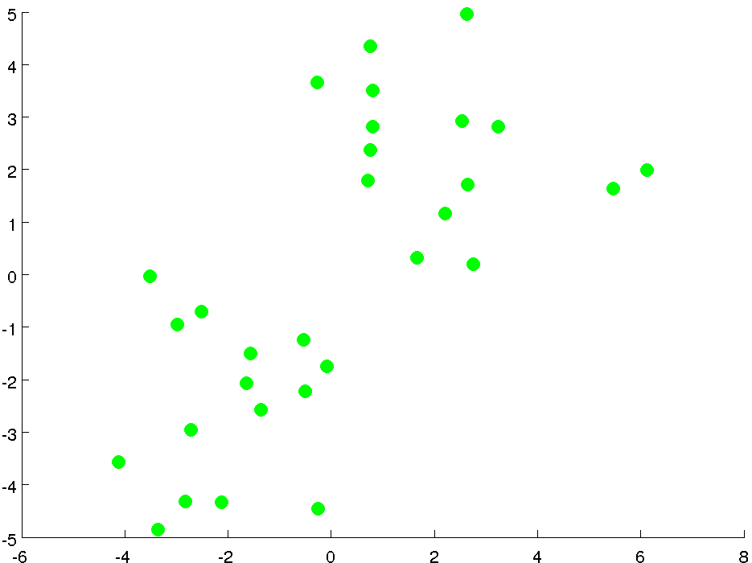

Slide 9
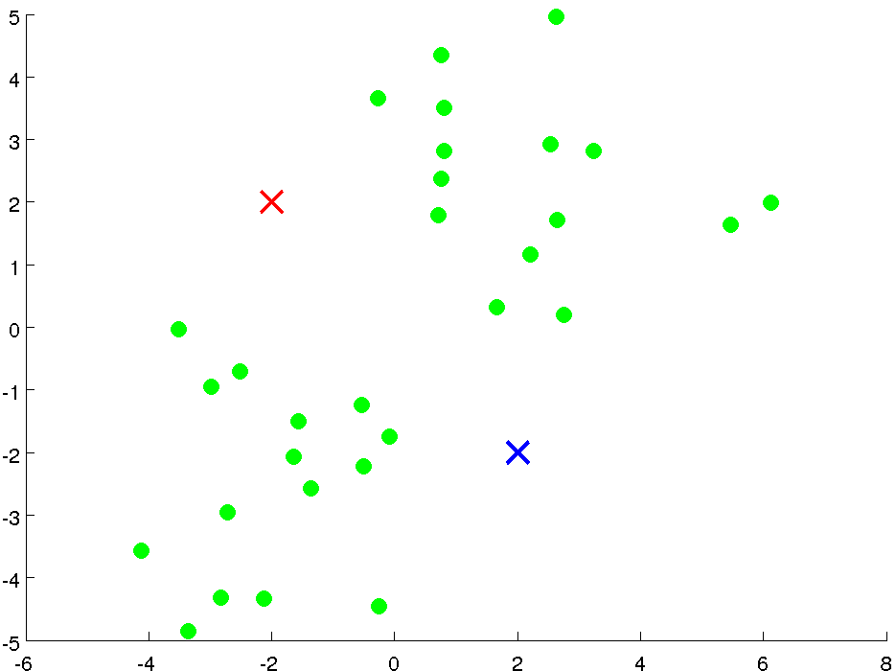

Slide 10
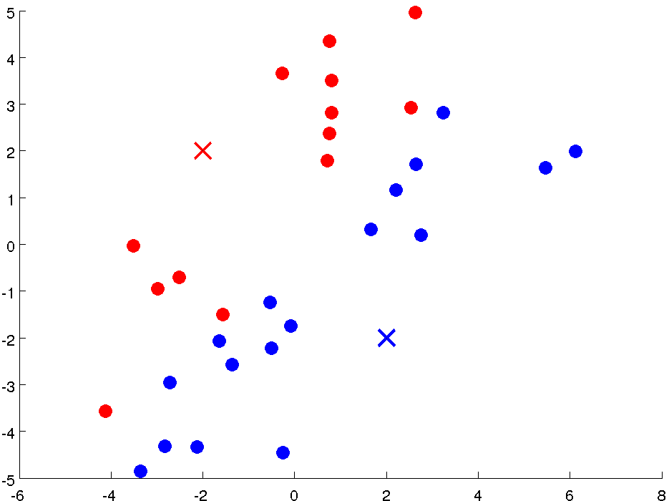

Slide 11
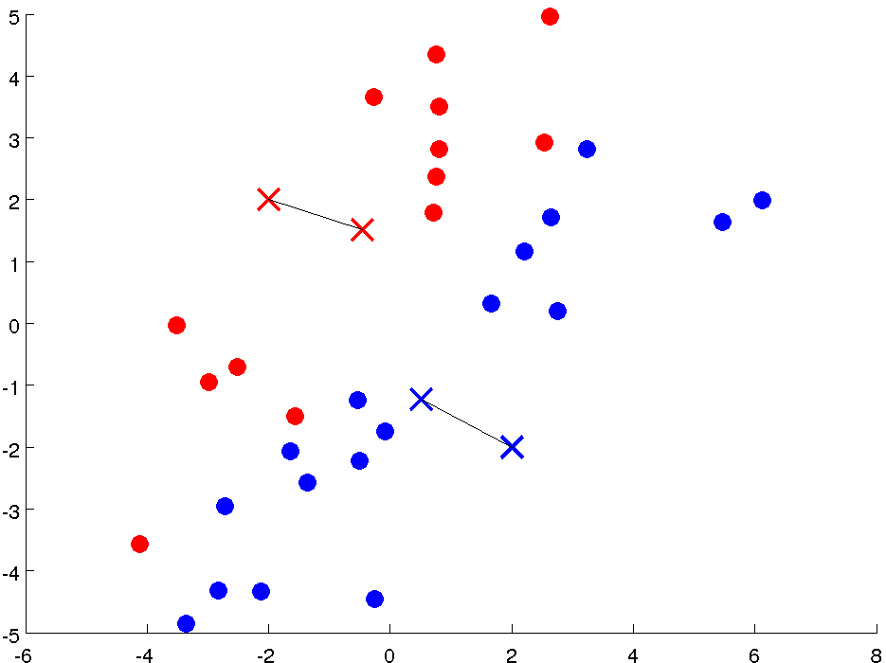

Slide 12
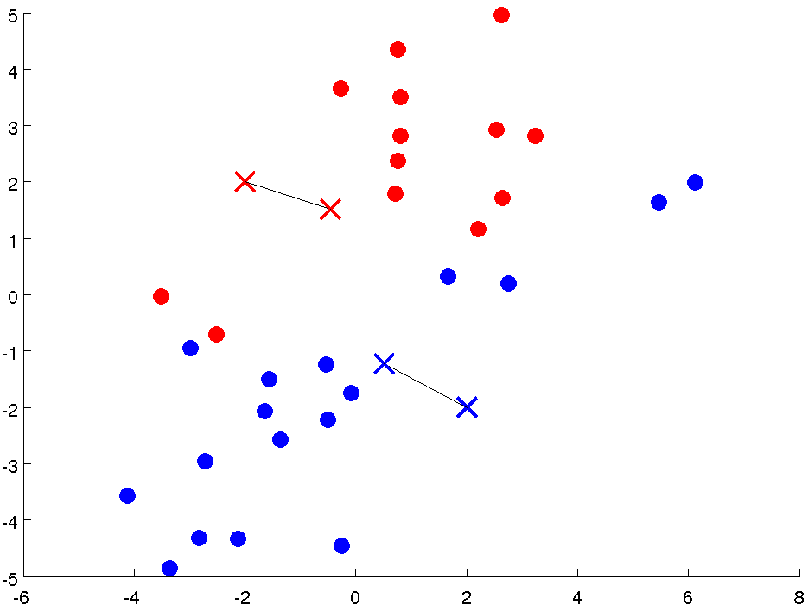

Slide 13
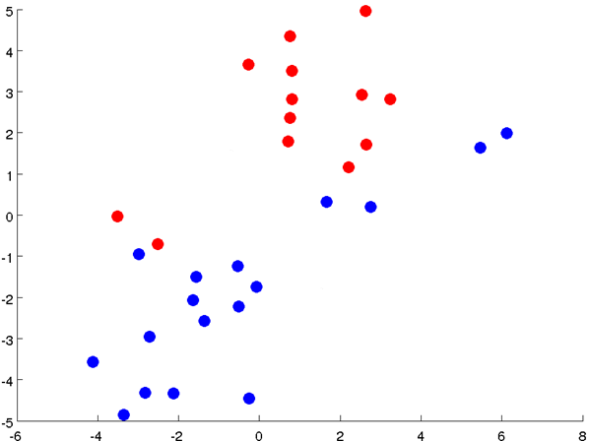

Slide 14
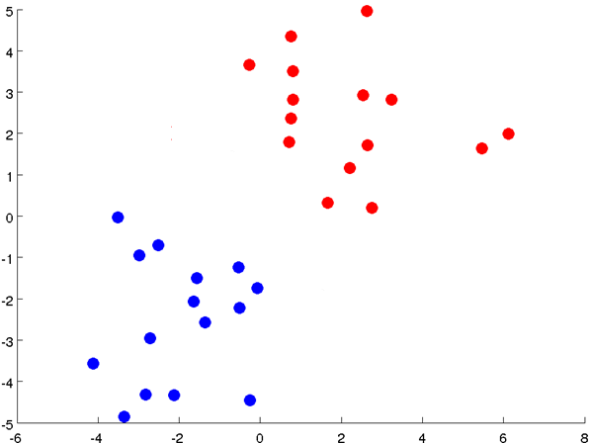

Slide 15
Notes:
Get rid of the legacy points

Slide 16
Notes:
Get rid of the legacy points

Slide 17

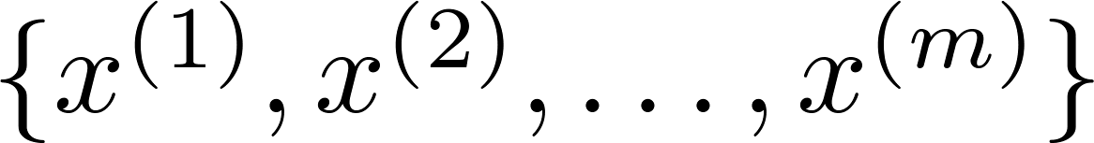
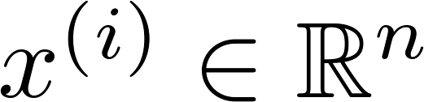
K-means Algorithm
Input:
(number of clusters)
Training set

Slide 18

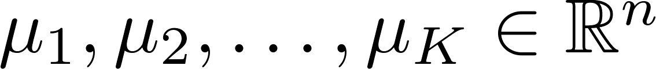
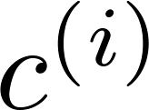
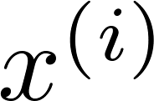

K-means algorithm
Randomly initialize cluster centroids
Repeat {
for = 1 to
:= index (from 1 to ) of cluster centroid
closest to
for = 1 to
:= average (mean) of points assigned to cluster
}
Notes:
Replace with normal text, size with LATEX fonts

Slide 19
Local optima

Slide 20
K-means algorithm
Randomly initialize cluster centroids
Repeat {
for = 1 to
:= index (from 1 to ) of cluster centroid
closest to
for = 1 to
:= average (mean) of points assigned to cluster
}
Notes:
Replace with normal text, size with LATEX fonts

Slide 21

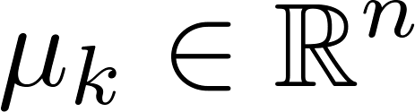

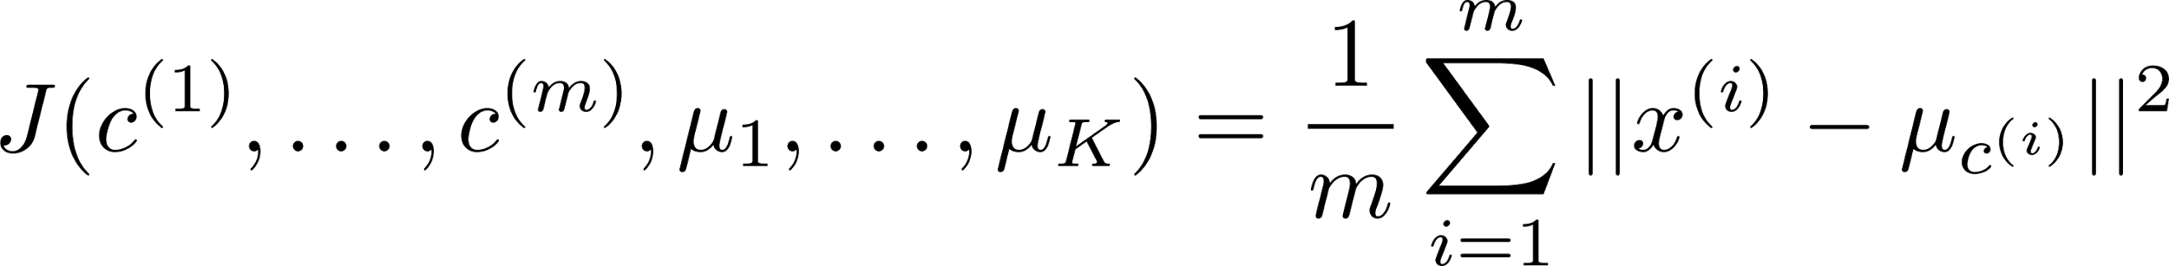
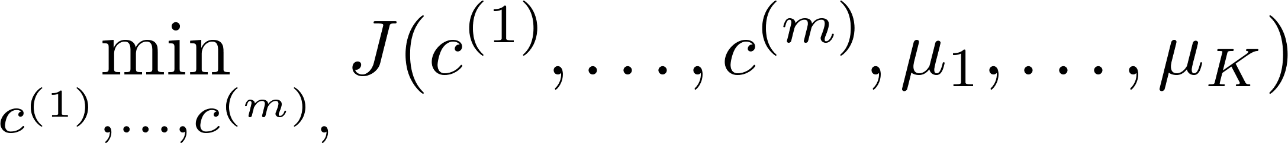

K-means optimization objective
= index of cluster (1,2,…, ) to which example is currently assigned
= cluster centroid ( )
= cluster centroid of cluster to which example has been assigned
Optimization objective:
Notes:
Change numbers to LATEX as well

Slide 22
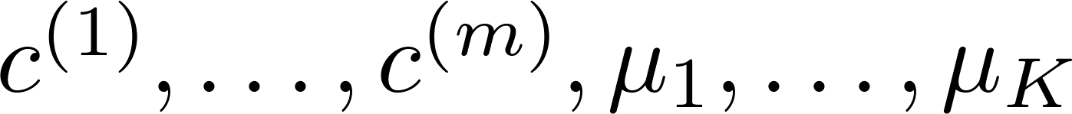
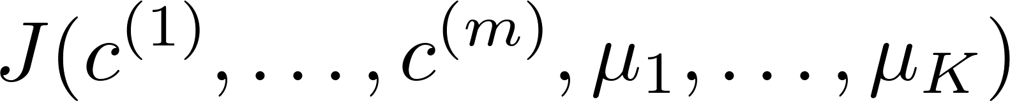
Random initialization
For i = 1 to 100 {
Randomly initialize K-means.
Run K-means. Get .
Compute cost function (distortion)
}
Pick clustering that gave lowest cost

Slide 23
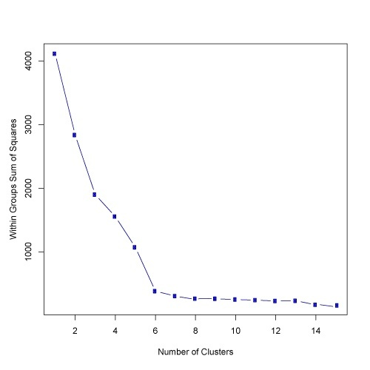
Choosing K
Elbow Method:

Slide 24
Dimensionality Reduction

Slide 25


Motivation I: Data Compression
Reduce data from
2D to 1D
(inches)
(cm)

Slide 26
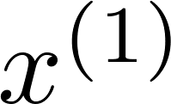
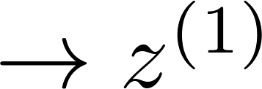
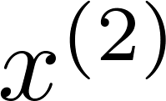
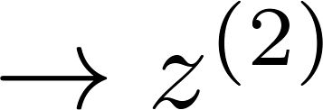
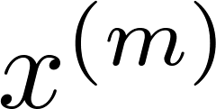
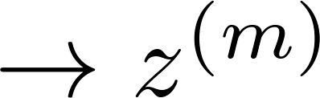

Motivation I: Data Compression
Reduce data from
2D to 1D
(inches)
(cm)
Notes:
Add more unique colors (3-4)

Slide 27
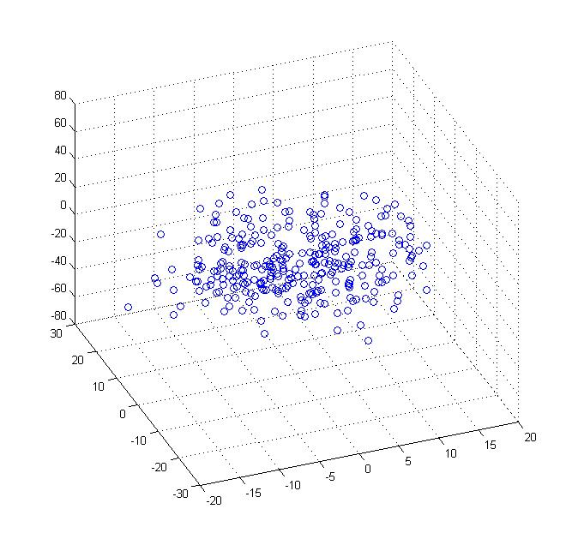
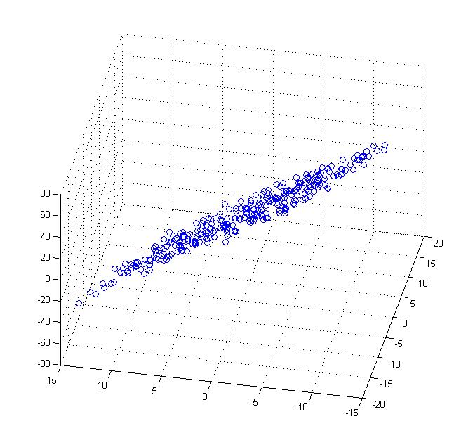
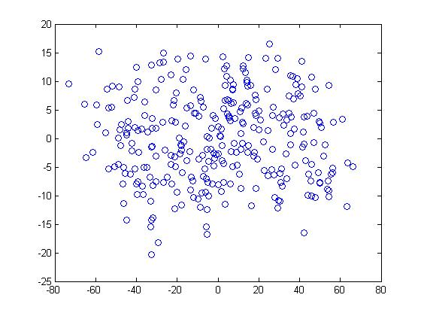


Motivation I: Data Compression
Reduce data from 3D to 2D
Notes:
Pca3d2d in lecture-slides/assets/pca/
Label axes

Slide 28
Motivation II: Data Visualization
Country | GDP (trillions of US$) | Per capita GDP (thousands of intl. $) | Human Develop-ment Index | Life expectancy | Poverty Index (Gini as percentage) | Mean household income (thousands of US$) | …
Canada | 1.577 | 39.17 | 0.908 | 80.7 | 32.6 | 67.293 | …
China | 5.878 | 7.54 | 0.687 | 73 | 46.9 | 10.22 | …
India | 1.632 | 3.41 | 0.547 | 64.7 | 36.8 | 0.735 | …
Russia | 1.48 | 19.84 | 0.755 | 65.5 | 39.9 | 0.72 | …
Singapore | 0.223 | 56.69 | 0.866 | 80 | 42.5 | 67.1 | …
USA | 14.527 | 46.86 | 0.91 | 78.3 | 40.8 | 84.3 | …
… | … | … | … | … | … | …
[resources from en.wikipedia.org]
Notes:
Add dots

Slide 29
Motivation II: Data Visualization
Country
Canada | 1.6 | 1.2
China | 1.7 | 0.3
India | 1.6 | 0.2
Russia | 1.4 | 0.5
Singapore | 0.5 | 1.7
USA | 2 | 1.5
… | … | …

Slide 30
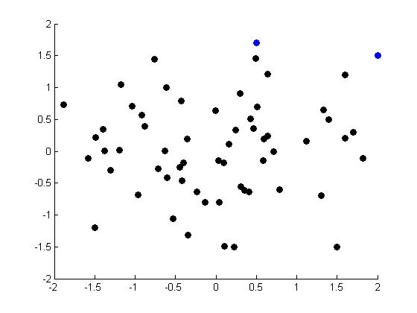
Motivation II: Data Visualization
Notes:
Make points look uncorrelated
US, Singapore in blue

Slide 31
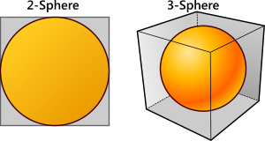
Motivation III: Curse of Dimensionality
Computational complexity is higher both for model creation and testing.
Sample complexiy (that is size of L) increases, often exponentially with the dimension d.
Many algorithms that use distance or similarity measures may not work in very high dimensional spaces.
Let Vs(r) be the volume of a d-dimensional sphere. A d-dimensional cube of side 2r that tightly encloses the sphere has a volume Vc(2r) = (2r)^{d}
Lim Vs/Vc = 0 d→∞

Slide 32

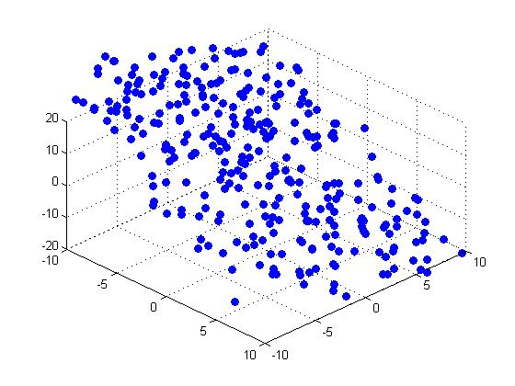


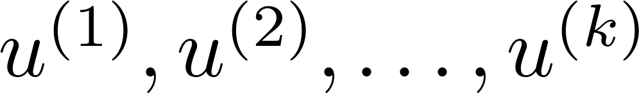
Principal Component Analysis (PCA) problem formulation
Reduce from 2-dimension to 1-dimension: Find a direction (a vector )
onto which to project the data so as to minimize the projection error.
Reduce from n-dimension to k-dimension: Find vectors
onto which to project the data, so as to minimize the projection error.
Notes:
Change numbers to LATEX as well

Slide 33
Principle Component Analysis(PCA): Algorithm

Slide 34
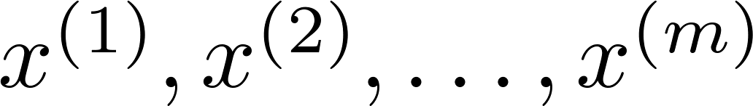
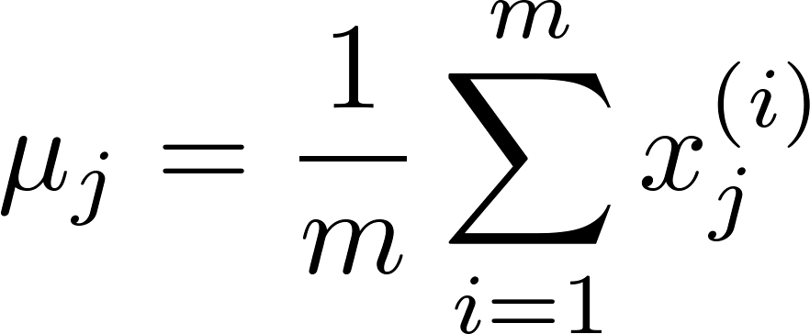
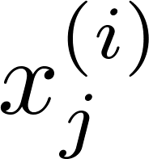



Data preprocessing
Training set:
Preprocessing (feature scaling/mean normalization):
Replace each with .
If different features on different scales (e.g., size of house,
number of bedrooms), scale features to have comparable range of values.
Notes:
Replace as previous; change spacing to fill page

Slide 35


Principal Component Analysis (PCA) algorithm
Reduce data from 2D to 1D
Reduce data from 3D to 2D
Notes:
Replace as previous; change spacing to fill page

Slide 36


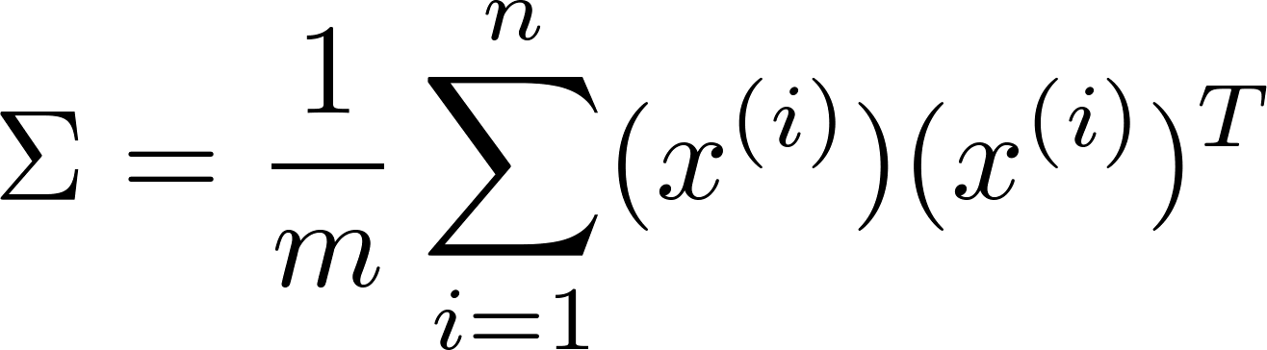

Principal Component Analysis (PCA) algorithm
Reduce data from -dimensions to -dimensions
Compute “covariance matrix”:
Compute “eigenvectors” of matrix :
[U,S,V] = svd(Sigma);

Slide 37
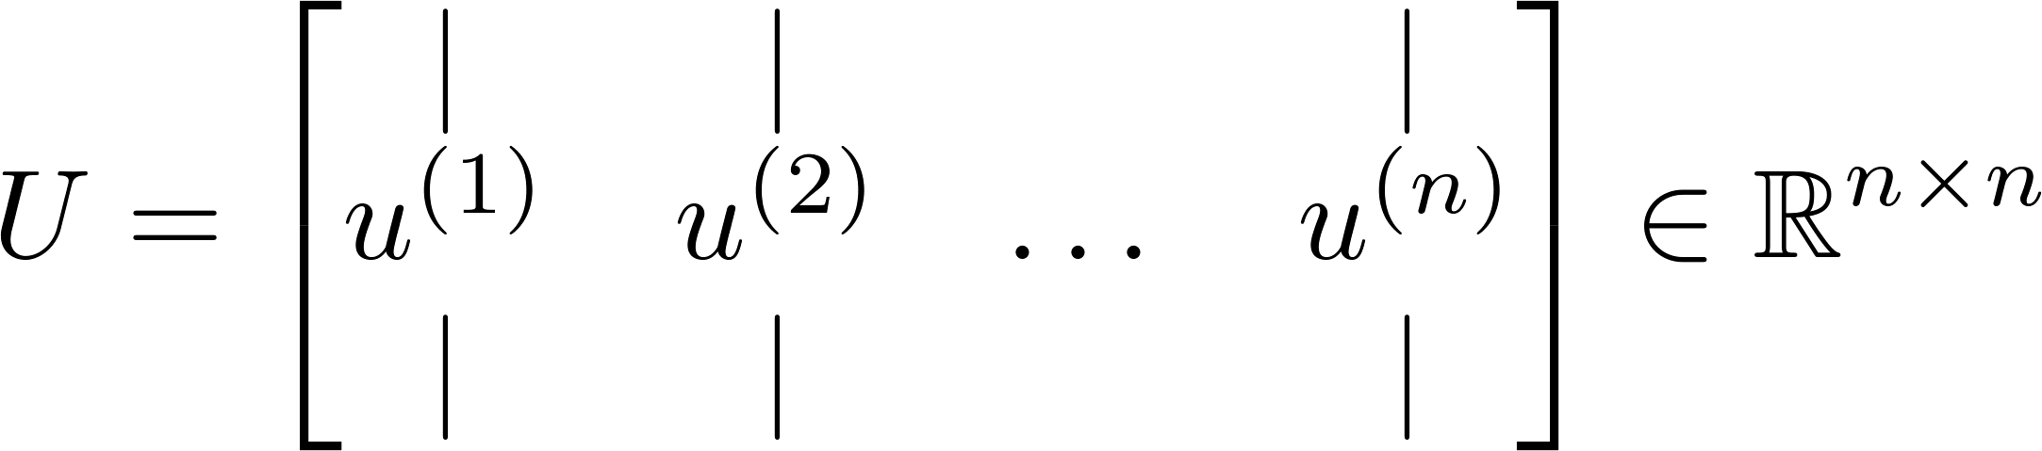
Principal Component Analysis (PCA) algorithm
From , we get:
[U,S,V] = svd(Sigma)

Slide 38
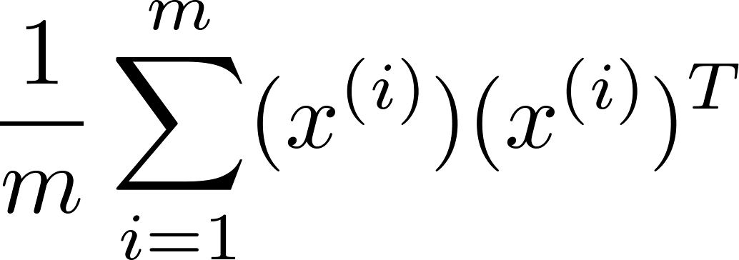
Principal Component Analysis (PCA) algorithm summary
After mean normalization (ensure every feature has zero mean) and optionally feature scaling:
Sigma =
[U,S,V] = svd(Sigma);
Ureduce = U(:,1:k);
z = Ureduce’*x;

Slide 39
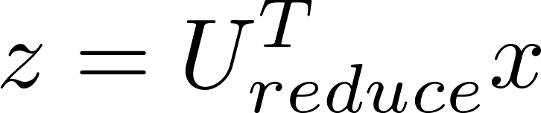
Reconstruction from compressed representation
Notes:
Make points have 0 mean on x1 and x2

Slide 40
What we have covered?
What we have not covered?
Unsupervised Learning - k-means
Dimensionality Reduction - PCA
Unsupervised Learning
Clustering - k-means, hierarchical, agglomerative, meanshift, spectral
Gaussian Mixture Model - Expectation Maximization
Manifold Learning
Neural Network Models
Dimensionality Reduction
PCA, KernelPCA, Matrix Factorization, ICA, Isomap etc.

